Slide 1
CSE 1107 Discrete Mathematics
Dola Das
Lecturer, CSE
KUET

Slide 2
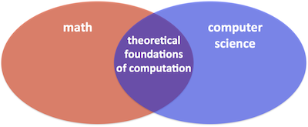
What is Discrete Mathematics?
Computer Science: use computer technology to solve problems.
Many courses in our curriculum will talk about computer technology.
This course will provide the mathematical foundation to solve problems,
e.g. to design a security system, to design a fast searching algorithm,
to analyze algorithms rigorously (e.g. pagerank and linear algebra), etc.

Slide 3
What does Discrete Mathematics tell about?
Continuous vs. Discrete Math Why is it in computer science? Mathematical techniques for DM

Slide 4
Discrete vs. Continuous Mathematics
Continuous Mathematics
It considers objects that vary continuously;
Example: analog wristwatch (separate hour, minute, and second hands).
From an analog watch perspective, between 1 :25 p.m. and 1 :26 p.m.
there are infinitely many possible different times as the second hand moves
around the watch face.
Real-number system --- core of continuous mathematics;
Continuous mathematics --- models and tools for analyzing real-world
phenomena that change smoothly over time. (Differential equations etc.)

Slide 5
Discrete vs. Continuous Mathematics
Discrete Mathematics
It considers objects that vary in a discrete way.
Example: digital wristwatch.
On a digital watch, there are only finitely many possible different times
between 1 :25 P.M. and 1:27 P.M. A digital watch does not show split
seconds: - no time between 1 :25:03 and 1 :25:04. The watch moves from one
time to the next.
Integers --- core of discrete mathematics
Discrete mathematics --- models and tools for analyzing real-world
phenomena that change discretely over time and therefore ideal for studying
computer science – computers are digital! (numbers as finite bit strings; data structures, all discrete! Historical aside: earliest computers were analogue.)

Slide 6
Discrete Mathematics vs. Continuous Mathematics
discrete mathematics
continuous mathematics
integers
real numbers
graphs
geometric space
induction
calculus
logic
These two areas are not disjoint, e.g. calculus can be
used to solve discrete problems (generating functions).

Slide 7
Why is it in computer science?
The conceptual center of computer science is the ALGORITHM.
Discrete Math helps provide…
…the machinery necessary for creating sophisticated algorithms
…the tools for analyzing their efficiency
…the means of proving their validity

Slide 8
Why is it in computer science?
In computer science we usually deal with finite, discrete objects.
For example, we cannot store a real number (infinite precision) in a computer but can only store bits (finite precisions).
We often model a computer network as a graph, and use the knowledge and techniques in dealing with graphs to solve problems in networks.
The problems and the techniques are often different (e.g. induction, recursion).

Slide 9
Why is it in computer science?
Although the point of CSE-1107 is to provide the tools for creating and analyzing sophisticated algorithms, we won’t focus on the algorithmic aspect, rather we will focus on the tools or discrete structures.
This course covers elementary discrete mathematics for computer science and engineering.

Slide 10
Mathematical techniques for DM
Review of functions, sets cardinality connectives
Prepositional calculus and predicate calculus
Proofs techniques
Mathematical Reasonic: Induction, Contradiction and recursion
Elementary Number Theory
Counting and Combinatorics
Graph and trees
Group : Basic algebra in groups ,cyclic group

Slide 11
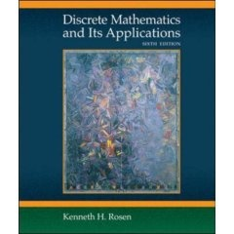
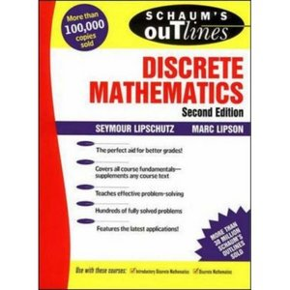

Textbook
Discrete Mathematics and Its Application
By Seymour Kenneth H. Rosen
Discrete Mathematics
By Seymour Lipschutz and Marc Lipson
www.google.com

Slide 12

Any Question

Slide 13


